Slide 1
Strings, StringBuilder, StringBuffer

Slide 2
String
Strings in java are immutable
Once created they cannot be altered and hence any alterations will lead to creation of new string object

Slide 3
Example
String s1 = “Example”
String s2 = new String(“Example”)
String s3 = “Example”
The difference between the three statements is that, s1 and s3 are pointing to the same memory location i.e. the string pool. s2 is pointing to a memory location on the heap.
Using a new operator creates a memory location on the heap.
Concatinting s1 and s3 leads to creation of a new string in the pool.

Slide 4
StringBuffer
StringBuffer is a synchronized and allows us to mutate the string.
StringBuffer has many utility methods to manipulate the string.
This is more useful when using in a multithreaded environment.
Always has a locking overhead.

Slide 5
Example
public class mybuffers{
public static void main(String args[]){
StringBuffer buffer = new StringBuffer(“Hi”);
buffer.append(“Bye”);
System.out.println(buffer);
}
}
This program appends the string Bye to Hi and prints it to the screen.

Slide 6
StringBuilder
StringBuilder is the same as the StringBuffer class
The StringBuilder class is not synchronized and hence in a single threaded environment, the overhead is less than using a StringBuffer.

Slide 7
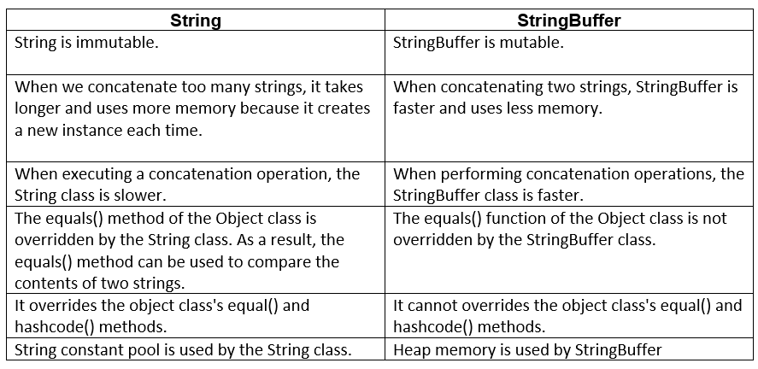

Slide 8
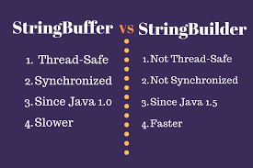

Slide 9
